Slide 2
QF608: Research Methods for Quantitative Professionals
Jin, Kim, Quek, Wang and Woon (2019)

Slide 3
The Fama-French Three-Factor Model
Research Null Hypothesis
Literature Review
Data, Research Design & Methodology
Summary of Statistics
Time-Series Regression Results
SMB, HML and UMD: A Deeper Dive
Conclusion
References

Slide 4
Research Null Hypothesis
1

Slide 5
Research Null Hypothesis
The three stock-market factors suggested by Eugene F. Fama and Kenneth R. French in their 1993 paper titled “Common Risk Factors in the Returns on Stocks and Bonds” do not significantly explain the returns of stocks listed on the NYSE, NASDAQ and AMEX for the period between Jul 2011 – Dec 2018.

Slide 6
Literature Review
2

Slide 7
Literature Review
The CAPM, developed by Sharpe (1964), Lintner (1965) and Black (1972) attempts to explain stock returns using excess market returns as an all-encompassing risk factor, an idea which was quickly popularised, but has since been met with much scrutiny and many empirical contradictions.
Amongst the critics of the CAPM are Fama and French (1993), who have built a case arguing that market excess returns alone do not fully explain cross-sectional variations in equity returns and that the addition of two empirically-backed factors are better explaining said variations. The model is also known as the Fama and French (1993) three-factor model:

Slide 8
Data, Research Design & Methodology
3

Slide 9
Data, Research Design & Methodology
Data Source:
Wharton Research Data Services (WRDS)
Center for Research in Security Prices (CRSP)
Compustat – Capital IQ
CRSP/Compustat Merged (CCM)

Slide 10
CRSP
Available Relevant Data (Monthly)
Closing Stock Price
Number of Shares Outstanding
Returns (Simple, Dividend, Delisting)
Identifiers
PERMCO
PERMNO
CUSIP – Not unique
Ticker – Not unique

Slide 11
Compustat – Capital IQ
Available Relevant Data (Balance Sheet, Annual)
Total Stockholders’ Equity
Deferred Taxes
Investment Tax Credit
Preferred Stock (Redemption, Liquidation, Carrying Values)
Identifiers
GVKEY
IID
CUSIP – Not unique
Ticker – Not unique, different from CRSP tickers

Slide 12
CRSP vs Compustat
Entity Level: PERMCO (CRSP) and GVKEY (Compustat) do not always agree, difficult to obtain perfect matching between datasets. As such, 1 PERMCO may correspond to multiple GVKEY and vice versa.
CRSP/Compustat Merged (CCM) tries to bridge the gap but some crucial data (e.g. number of shares outstanding) is missing/formatted in an inconvenient manner.
Solution: Use CCM to obtain entity level matching data, then raw data was obtained from standalone datasets. New identifier GVKEY PERMCO was created for purposes of traversing between datasets.
Example: If Apple Inc’s GVKEY is 1690 and its PERMCO is 7, its GV KEY PERMCO is 16907, which is a unique identifier.

Slide 13
Other Issues in Data
Missing Data – E.g. No returns data available when it should be
Incomplete Dataset – CRSP & Compustat do not cover the whole population of NYSE, NASDAQ and Amex traded stocks, only an overlap is available
Repeat Data – Double reporting of same company for same period
Conflicting Data – Standalone CRSP & Compustat vs. CCM
Computational Cost – Takes hours to compute several million cells

Slide 14
Data, Research Design & Methodology
Research Design & Methodology:
Size
Book to Market Equity
SMB & HML
Rm-Rf
Quantile Based Portfolios

Slide 15
Size
Formulas
Size = Market Capitalisation of the Firm at June of time t
Market Capitalisation = Share Price x Number of Shares Outstanding
Small vs. Big
Every year, Sizes of firms traded on the NYSE, NASDAQ and Amex (where available) are computed.
Then, for only NYSE-traded firms, Size is ranked, then the median is used as the distinguisher between Small and Big companies.

Slide 16
Book-to-Market Equity
Formulas
Book-to-Market Equity= BE/ME
Book Common Equity (BE) = (Total Stockholders’ Equity + Deferred Taxes + Investment Tax Credit – Book Value of Preferred Stock) of the Firm at time t-1.
Book Value of Preferred Stock = Redemption, Liquidation or Carrying Value of Preferred Stock, in that order, when available.
Market Common Equity (ME) = Market Capitalisation of the Firm at December of time t-1.
High vs. Low
Every year, positive-only BE-ME for firms traded on the NYSE, NASDAQ and Amex (where available) are computed.
Then, for only NYSE-traded firms, BE-ME is ranked, then cut off points of 30% and 70% are used as distinguishers of Low, Medium and High firms.
Low = Bottom 30%, Medium = Next 40%, High = Top 30%

Slide 17
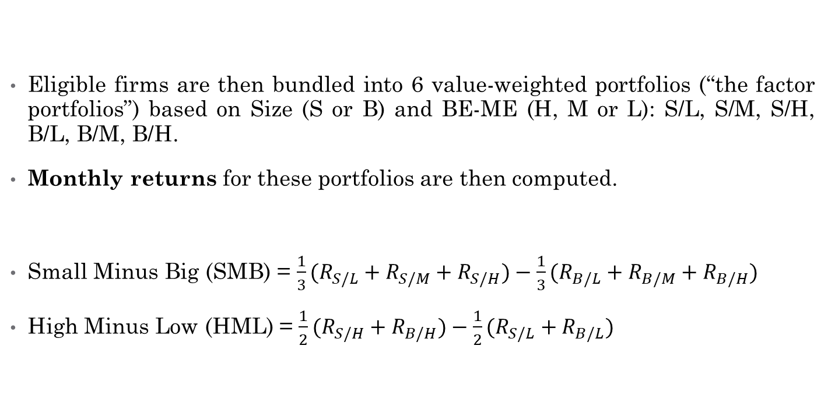
SMB & HML Factors
Eligible firms are then bundled into 6 value-weighted portfolios (“the factor portfolios”) based on Size (S or B) and BE-ME (H, M or L): S/L, S/M, S/H, B/L, B/M, B/H.
Monthly returns for these portfolios are then computed.
Small Minus Big (SMB) = $\frac{1}{3}(R_{S/L}+R_{S/M}+R_{S/H})−\frac{1}{3}(R_{B/L}+R_{B/M}+R_{B/H})$
High Minus Low (HML) = $\frac{1}{2}(R_{S/H}+R_{B/H})−\frac{1}{2}(R_{S/L}+R_{B/L})$

Slide 18
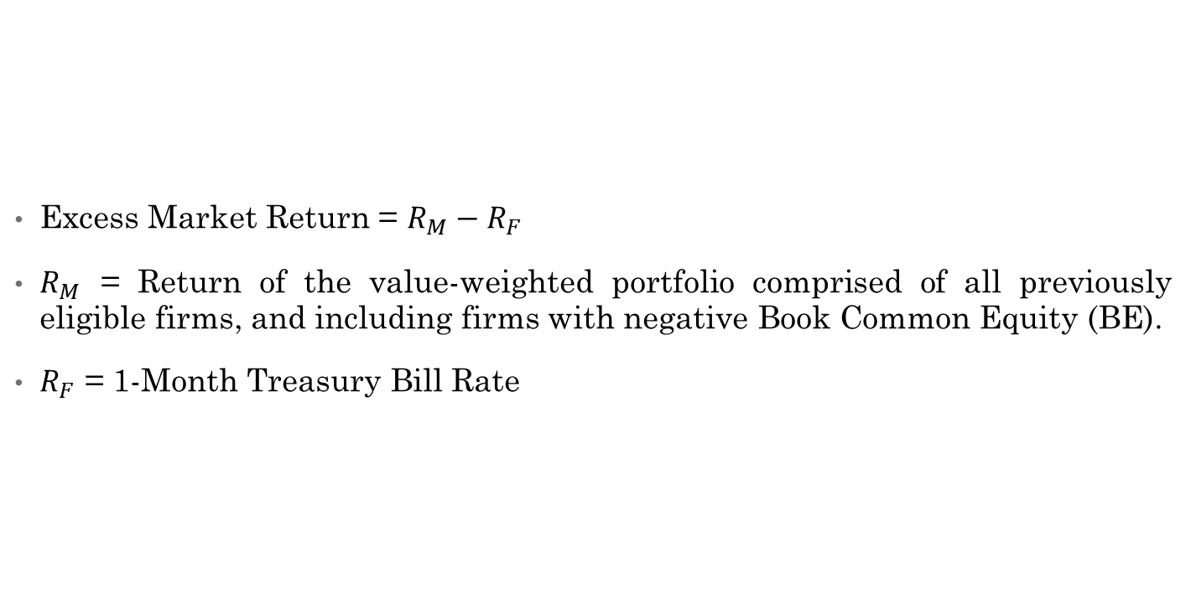
Excess Market Return Factor
Excess Market Return = $R_{M}−R_{F}$
$R_{M}$ = Return of the value-weighted portfolio comprised of all previously eligible firms, and including firms with negative Book Common Equity (BE).
$R_{F}$ = 1-Month Treasury Bill Rate

Slide 19
Quintile-Based Portfolios
The same firms eligible for the 6 factor portfolios are then bundled into 25 portfolios based on their Size and Book-to-Market Equity quintiles.
Again, NYSE-based breakpoints are used to distinguish the firms into their respective quintiles.
Monthly returns for these portfolios are then computed, and regressed against the three Fama-French factors introduced earlier.

Slide 20
Summary of Statistics
4

Slide 21
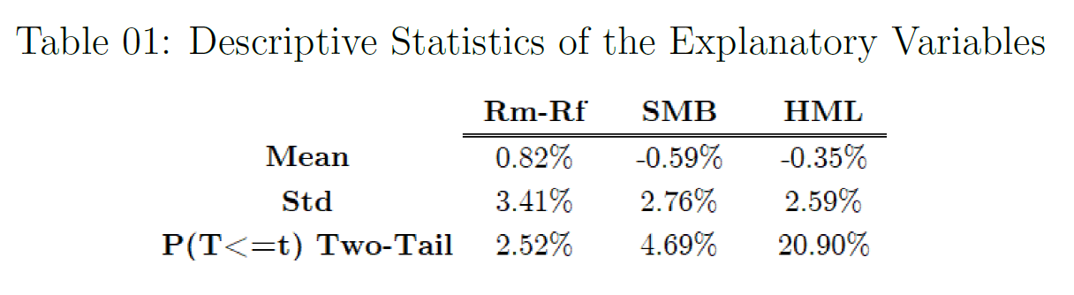
Summary of Statistics
The Explanatory Variables:

Slide 22
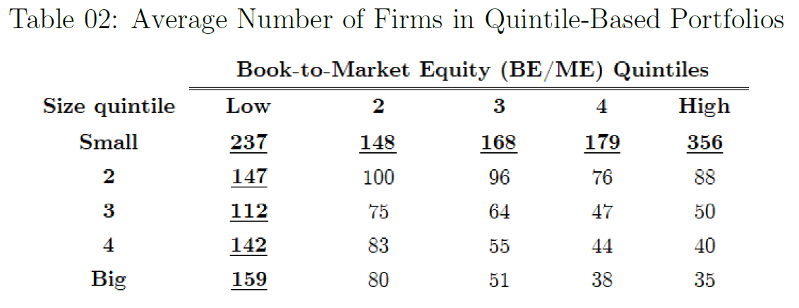
Summary of Statistics
The Dependent Variables:

Slide 23
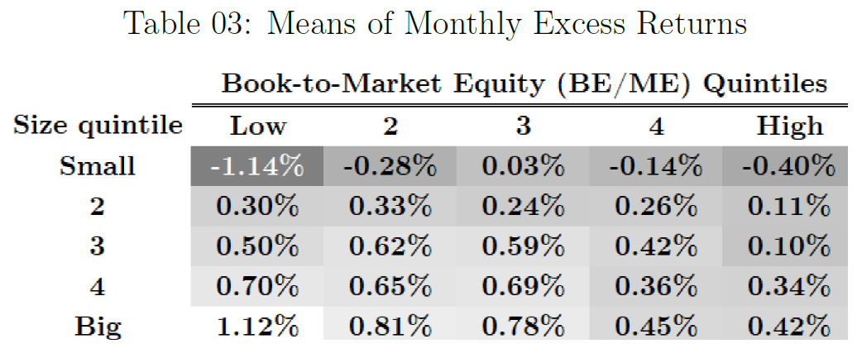
Summary of Statistics
The Dependent Variables:

Slide 24
Regression Analysis
5

Slide 25
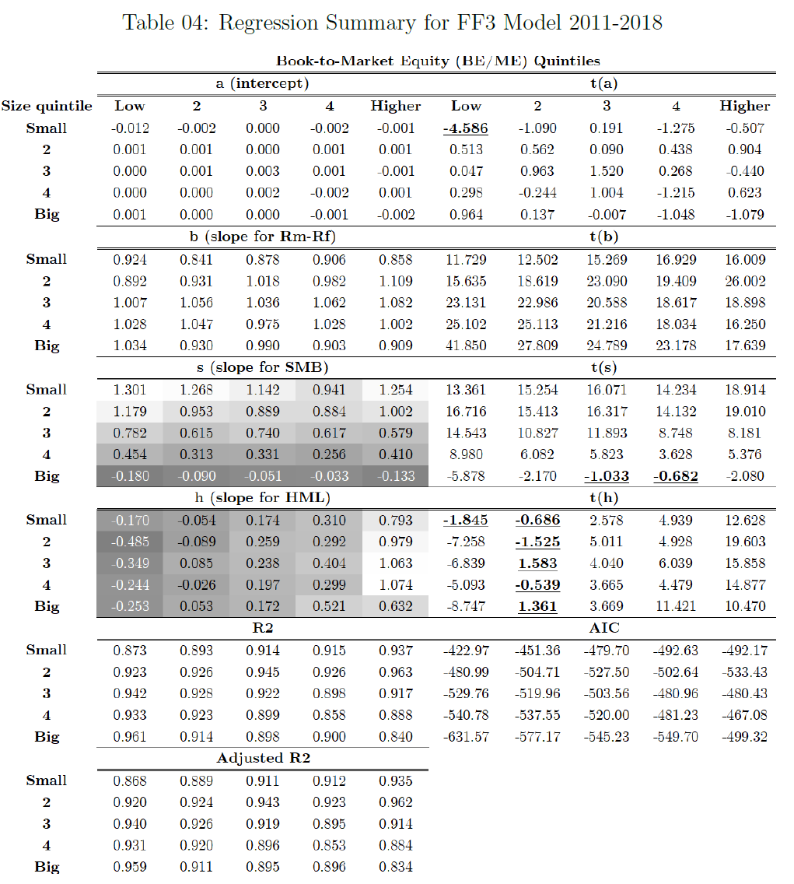
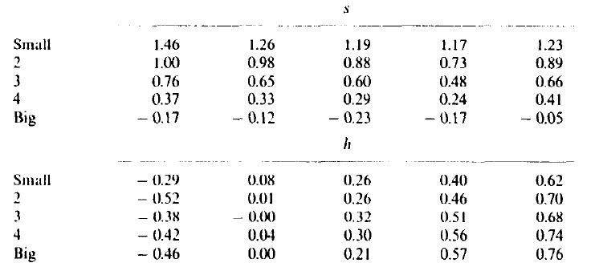
FF3 (2011-2018) vs FF3(1963-1991)

Slide 26
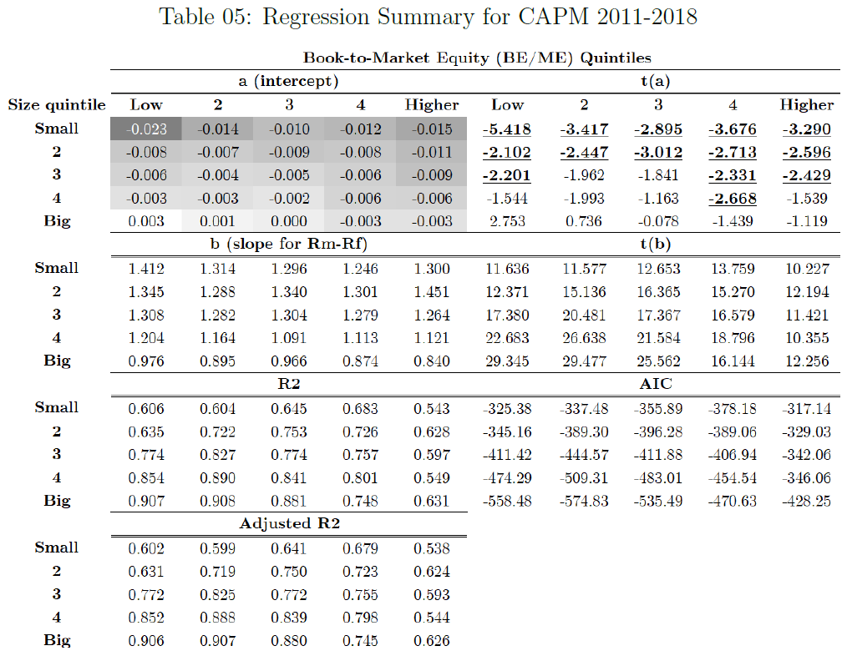
FF3 (2011-2018) vs CAPM(2011-2018)

Slide 27
SMB, HML and UMD: A Deeper Dive
6

Slide 28
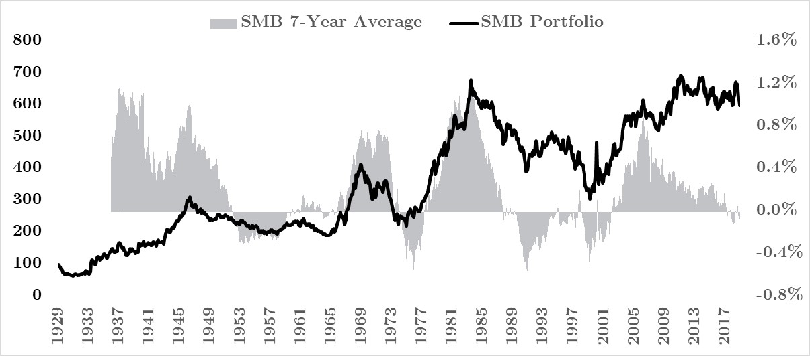
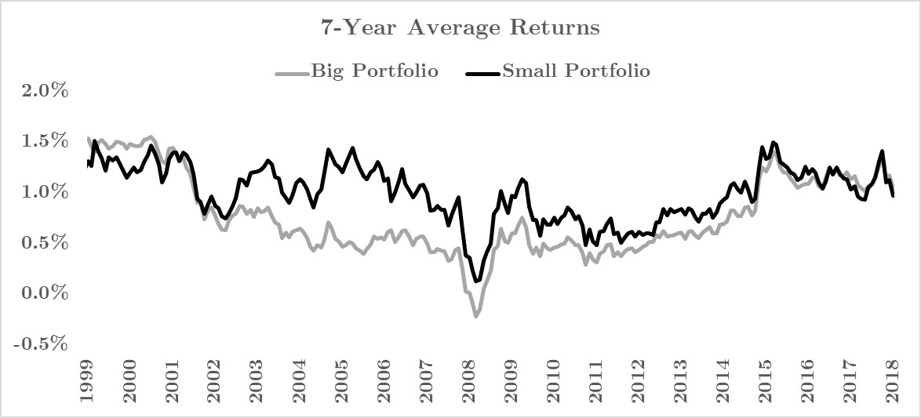
Small Minus Big (SMB) Factor
SMB factor realisations do not exhibit consistently positive readings over our sample period, though said SMB readings are, on average, mildly positive (at 0.21%).
The rolling 7-year SMB average shows how the SMB factor realisations have trended in and out of positive territories over our extended sample period.
Net gain the portfolio has clocked over the extended sample period suggests that SMB factor realisations are still on average, positive.
The sample period used in our main study (July 2011 - December 2018) happens to denote a time period when rolling 7-year average SMB factor realisations are negative, explaining the divergence.
Delving deeper, we found the main driver behind the recent downtrend in rolling 7-year average SMB factor realisations stem mainly from movements in rolling 7-year Big portfolio returns.

Slide 29
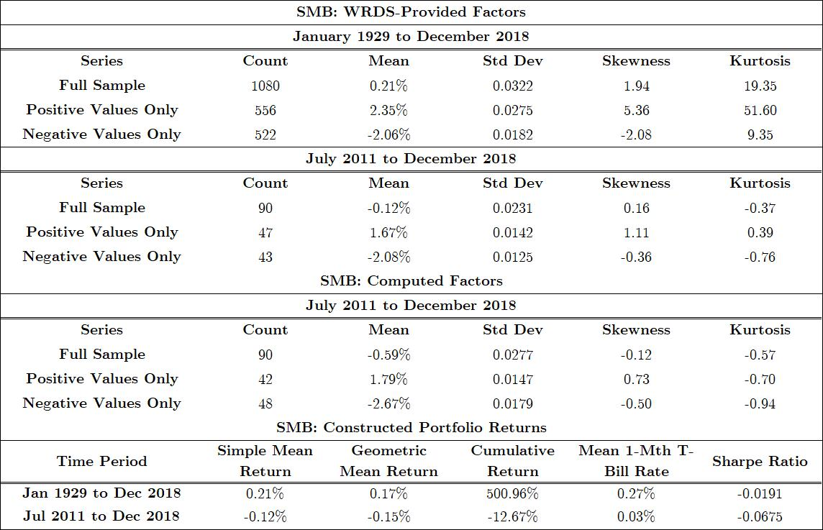
Small Minus Big (SMB) Factor

Slide 30
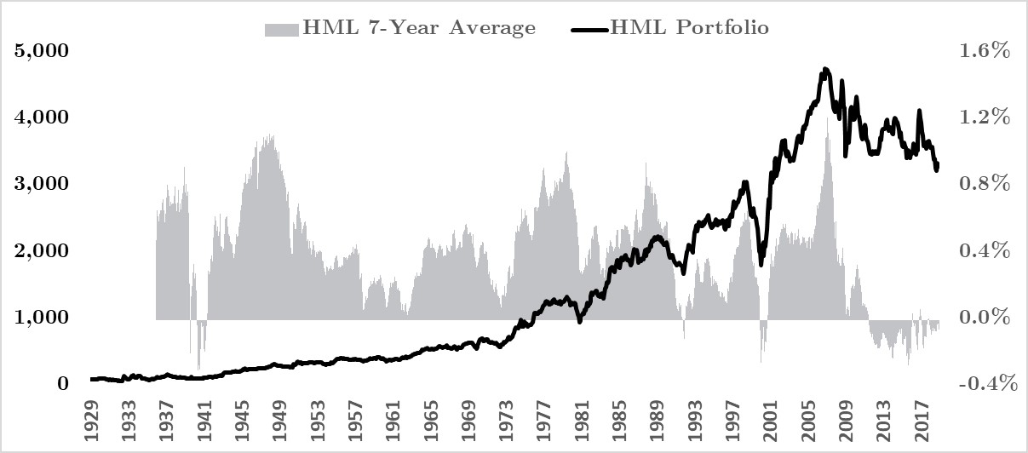
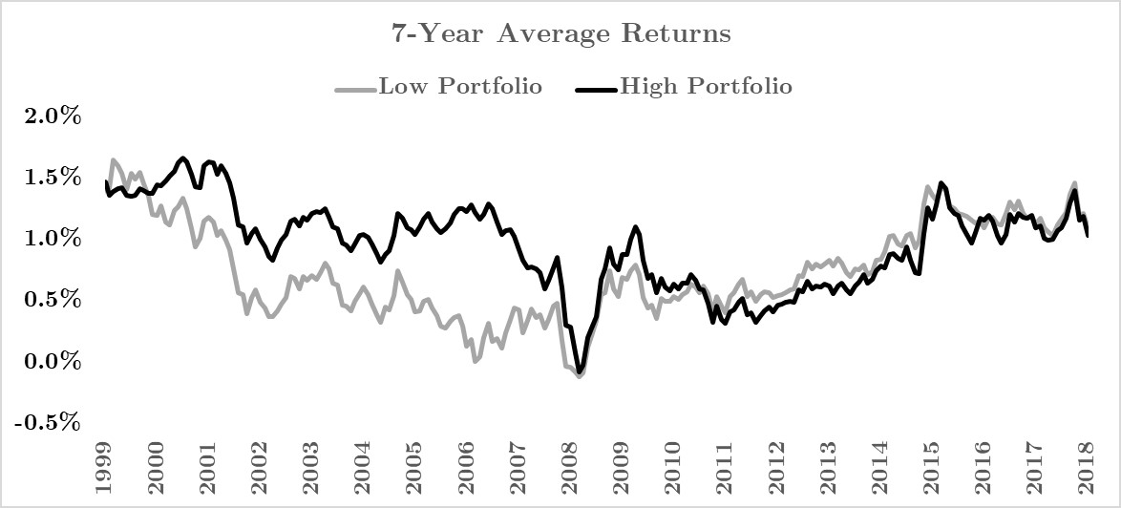
High Minus Low (HML) Factor
The HML factor was observed to exhibit mildly negative mean readings for the period between July 2011 and December 2018, though the HML factor's mean reading of -0.10% is deemed to be statistically indifferent from 0 at the 5% level.
The HML factor was seen to have displayed more consistently and persistently positive readings over the extended sample period of between January 1929 and December 2018 compared to the SMB factor.
This makes the unravelling of the HML factor's positive readings over the recent decade all the more an unprecedented one, which also explains the divergence between our observed mean HML and that of Fama and French (1993).
Our constructed HML portfolio has grossly outperformed our constructed SMB portfolio over the extended sample period in terms of nominal returns.
The HML portfolio clocked 3,200.59% returns while the SMB portfolio only clocked 500.96%, with the latter's Sharpe ratio coming up as negative for returns over the extended sample period.

Slide 31
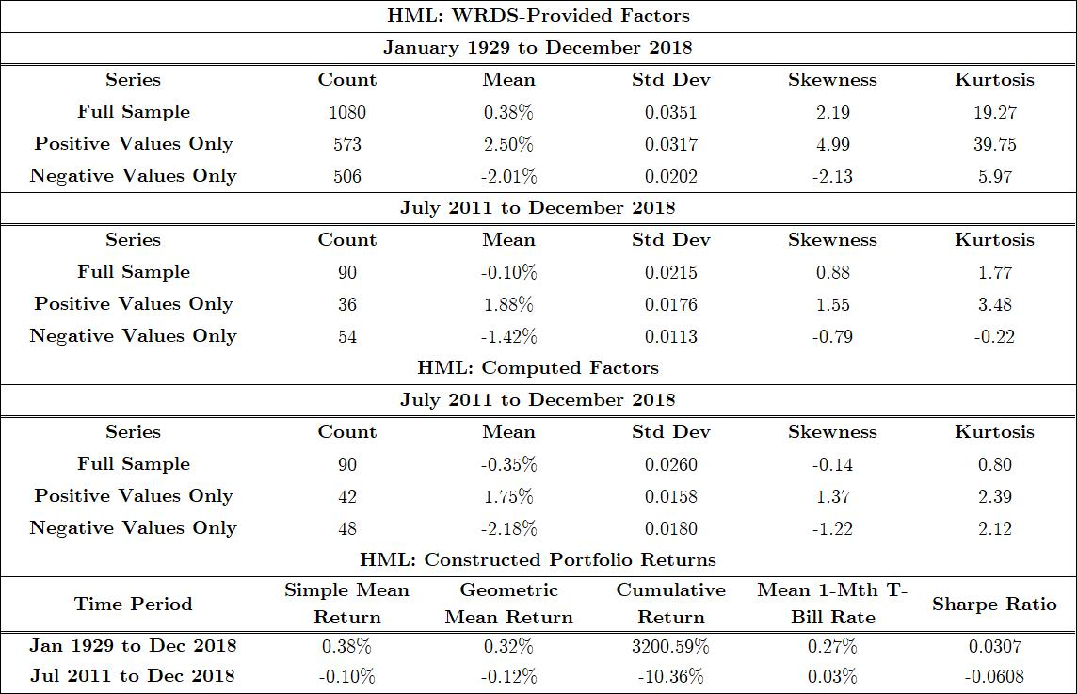
High Minus Low (HML) Factor

Slide 32
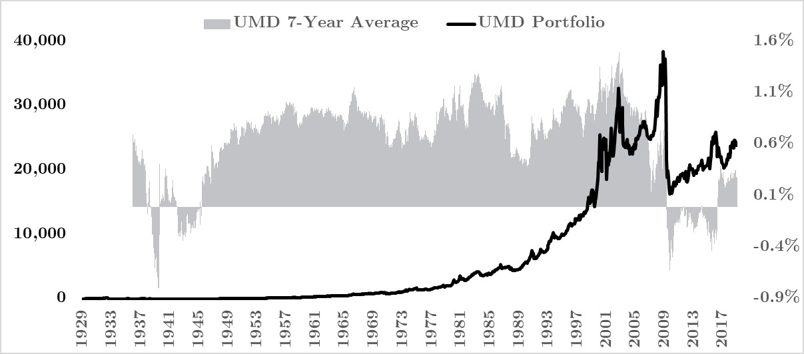
Bonus: Up Minus Down (UMD) Factor
We also looked at one of the additional stock market factors introduced and popularised by Carhart (1997): the momentum factor (UMD).
Like the HML factor, it was observed that the UMD factor is consistently and persistently positive.
Also, like the SMB and HML factors, we observed an unravelling of the long UMD play in the recent decade, though said unravelling took place relatively earlier from April 2009 and has already recovered since April 2016.
In terms of cumulative returns, the long UMD play has grossly outperformed both the long SMB play and the long HML play, with cumulative nominal returns of 24,252.43% observed over the extended sample period and 24.18% over the original sample period.
On a risk-adjusted basis and in terms of Sharpe ratios, the long UMD outperforms the long SMB play and the long HML play too.

Slide 33
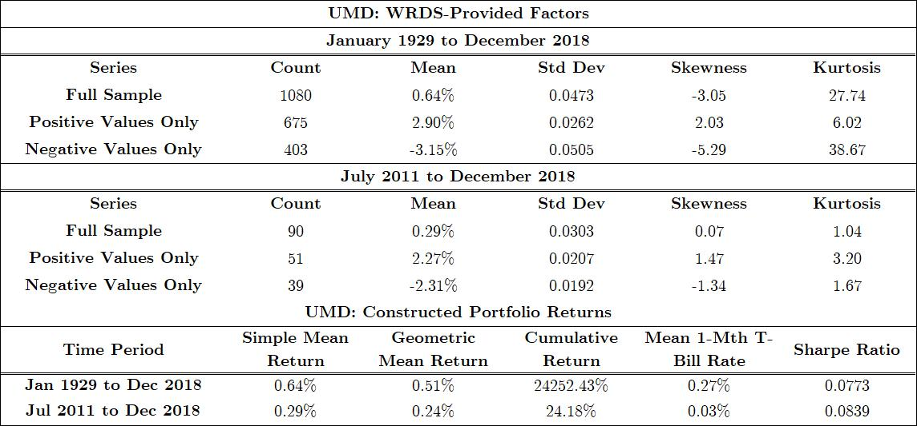
Bonus: Up Minus Down (UMD) Factor

Slide 34
Conclusion
7

Slide 35
Conclusion
Research Null Hypothesis Revisited:
The three stock-market factors suggested by Eugene F. Fama and Kenneth R. French in their 1993 paper titled “Common Risk Factors in the Returns on Stocks and Bonds” do not significantly explain the returns of stocks listed on the NYSE, NASDAQ and AMEX for the period between Jul 2011 – Dec 2018.
Conclusion: We Reject Our Research Null Hypothesis.
Additional Finding:
SMB factor turns negative in our testing period due to recent large cap relative outperformance.

Slide 36
References
8

Slide 37
Reference List
Markowitz, H. (1952). Portfolio selection. The Journal of Finance, 7(1), 77-91.
Sharpe, W. (1964). Capital asset prices: A theory of market equilibrium under conditions of risk. Journal of Finance, 19(3), 425-442.
Lintner, J. (1965). The valuation of risk assets and the selection of risky investments in stock portfolios and capital budgets. Review of Economics and Statistics, 47(1), 12-37.
Black, Fischer. Michael C. Jensen. and Myron Scholes. (1972). The capital asset pricing model: Some empirical tests. in: M. Jensen. ed.. Studies In the theory of capital markets (Praeger, New York, NY).
Fama, E., & French, K. (1993). Common risk factors in the returns on stocks and bonds.Journal of Financial Economics, 33(1), 3-56..
Fama. Eugene F. and Kenneth R. French. (1992a). The cross-section of expected stock returns.Journal of Finance 47, 427 - 465.
Banz. Rolf W.. 1981. The relationship between return and market value of common stocks, Journal of Financial Economics 9. 3-15.
Daniel, K., & Titman, S. (1997). Evidence on the characteristics of cross sectional variation in stock returns
Notes:
To prove fit of data for OLS

